Slide 1
Predict video games rating
By shuruq batrah

Slide 2
INTRODUCTION
This project reviews a set of video game data rated by the ESRB for the purpose of monitoring and age-appropriate game content. The ESRB is officially recognized, implemented and used in the three main countries of North America: Canada, Mexico, and the United States. The Ai model will be built to predict the appropriate age rating for each game based on the data collected.

Slide 3
01
03
Data gathring and cleaining
Feature engineering
02
04
Data exploration
Predict the model

Slide 4
01.
Data gathring and cleaining

Slide 5
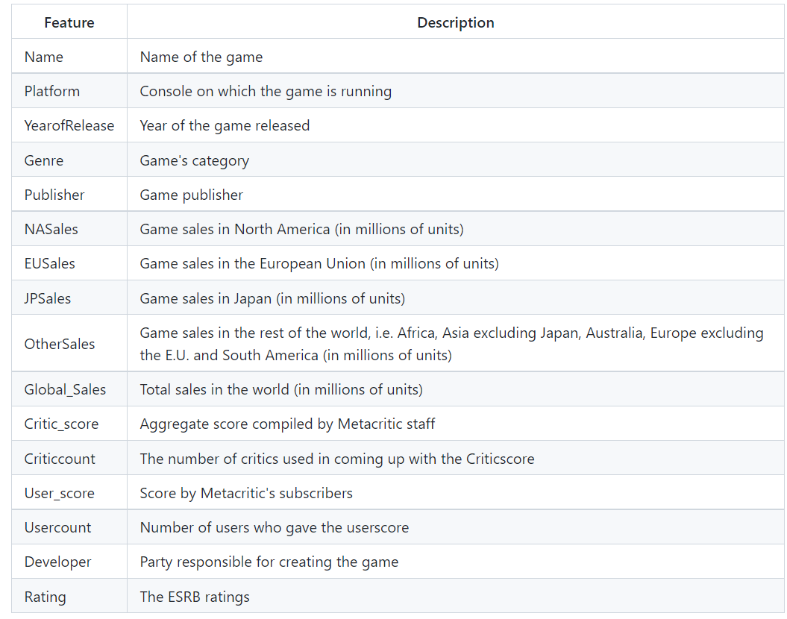
WHAT IS THIS TOPIC ABOUT?
Data sorce from Kaggle
The Dataset contains 16 columns and 16720 instances.

Slide 6
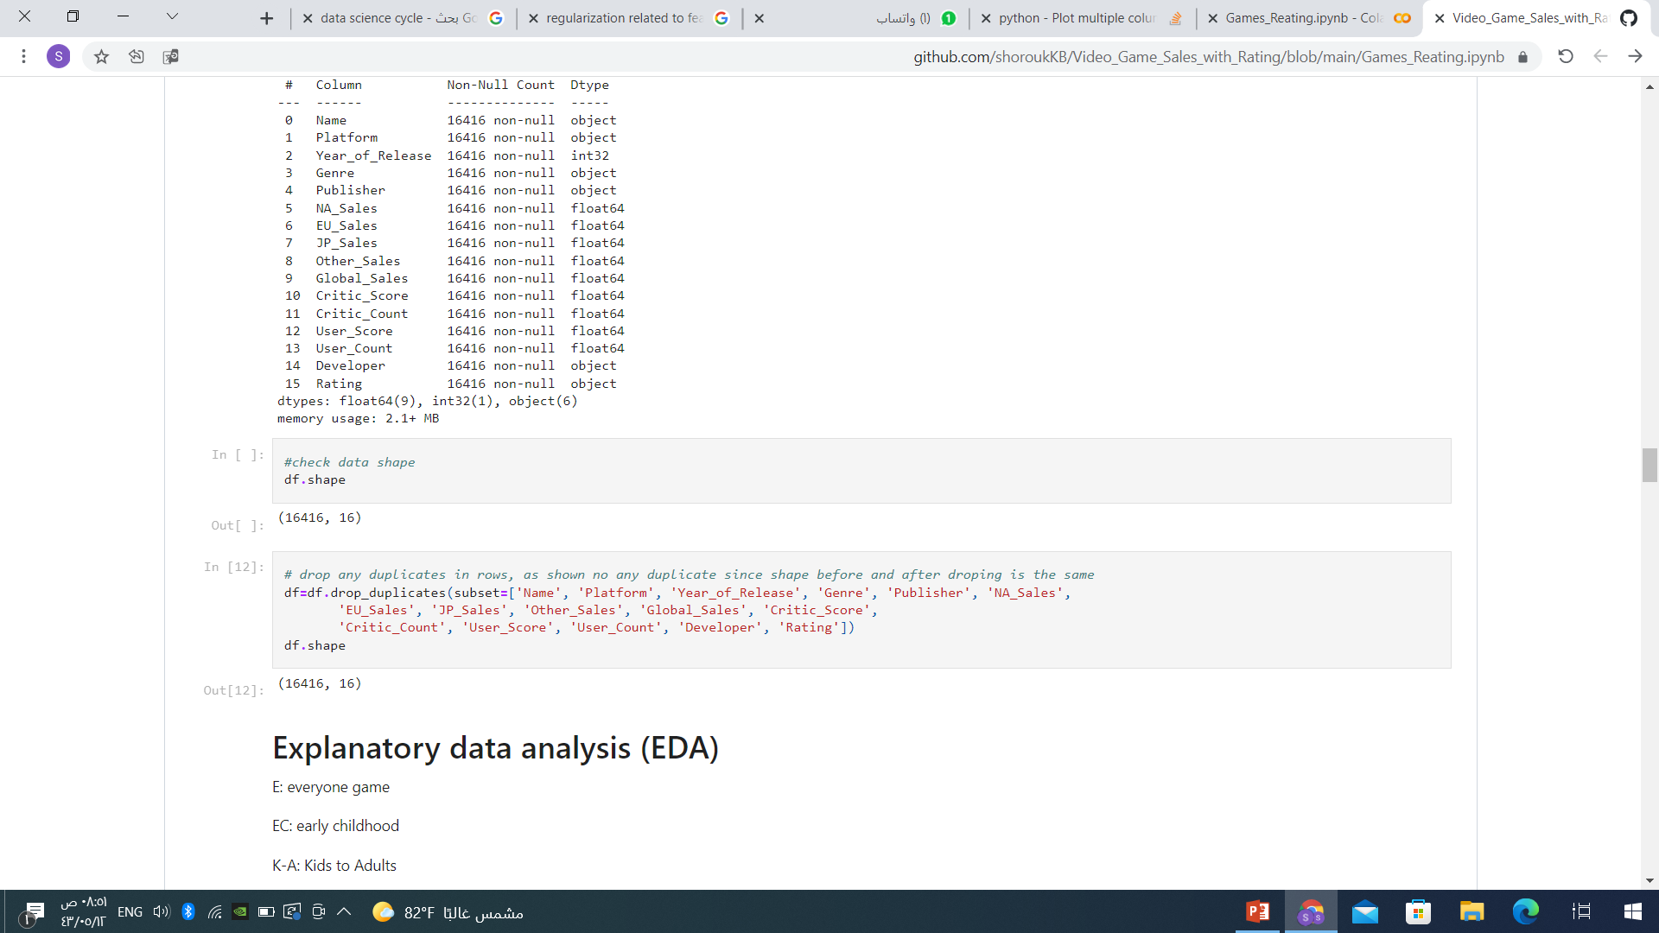
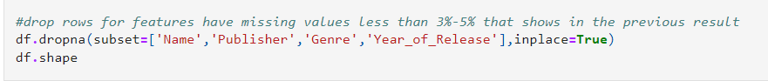
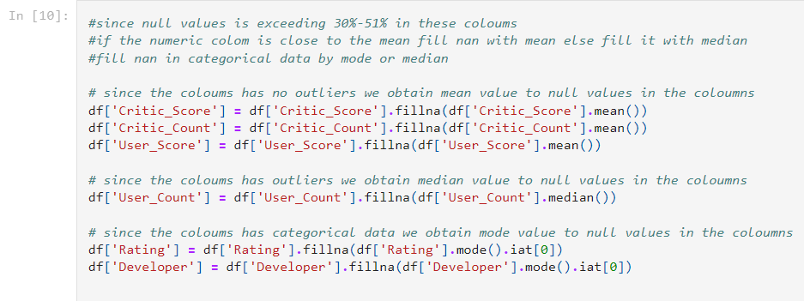
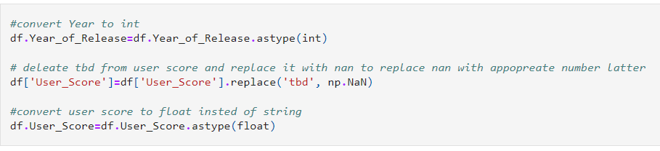
Data cleaining
Remove duplicate
Remove nan values
Correct typos and data type

Slide 7
02.
Data exploration

Slide 8
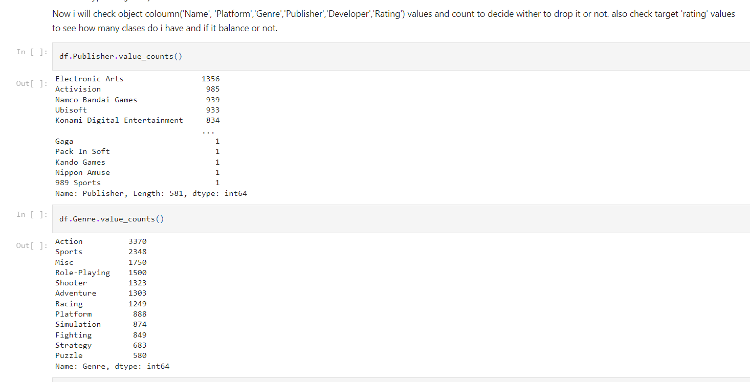

Slide 9
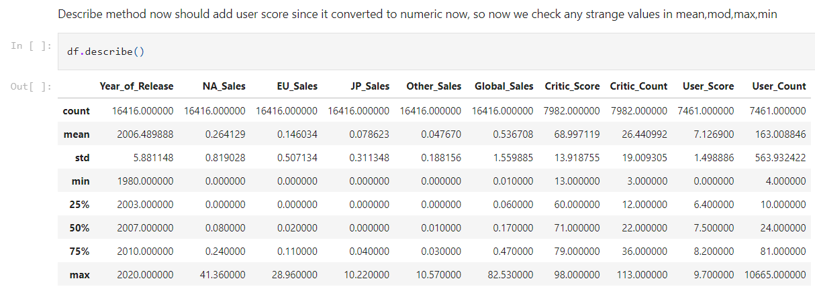

Slide 10
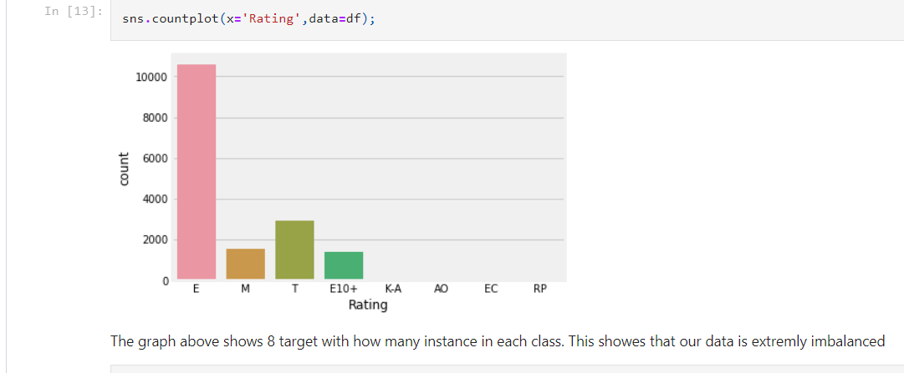
Target is rating meaning:
E: everyone game
EC: early childhood
K-A: Kids to Adults
E+10: age 10 and above
T: teen age 13 and above
M: mature age 17 and above
AO: adults only 18+
RB: rating binding

Slide 11
02.
Feature engineering

Slide 12
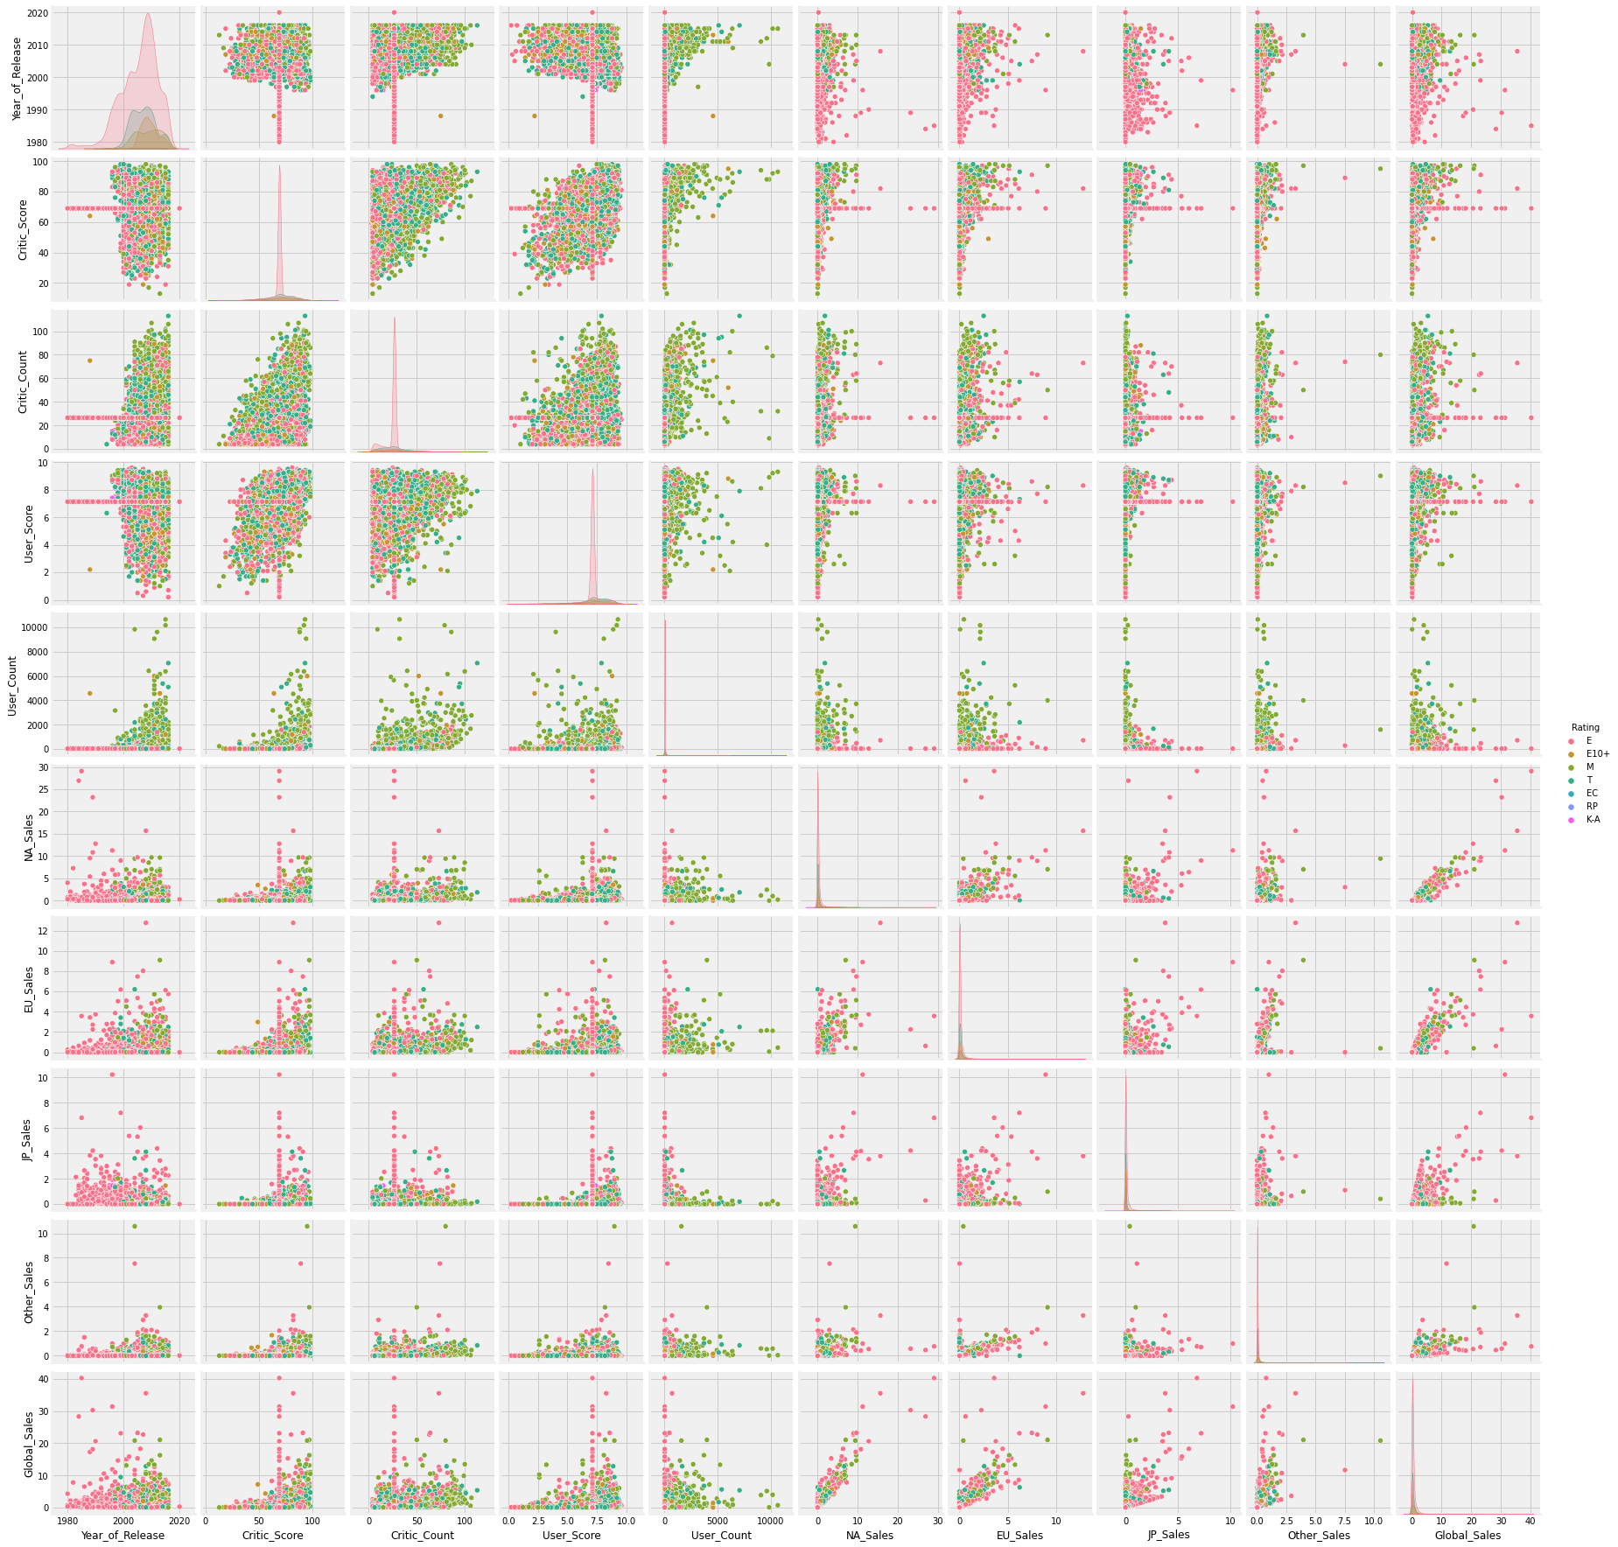
We notice that all the overlap area between features and target are small but only one overlapped is year

Slide 13
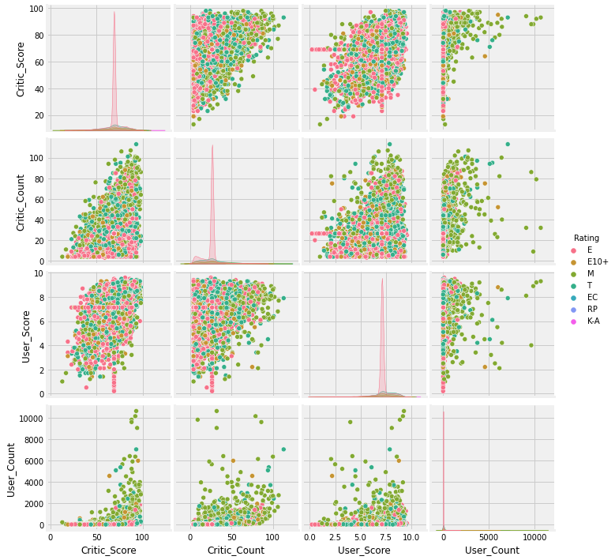
We notice that there is no relation between these feature with each other.

Slide 14
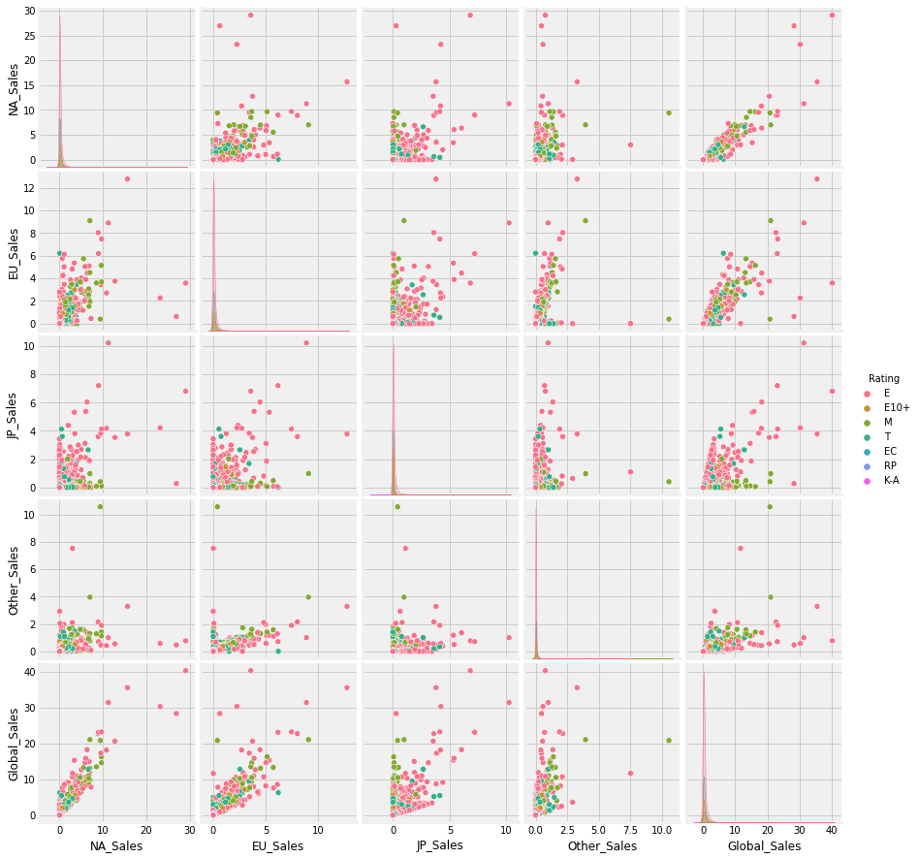
We notice that there is some positive relation between sales globally and in some countries

Slide 15
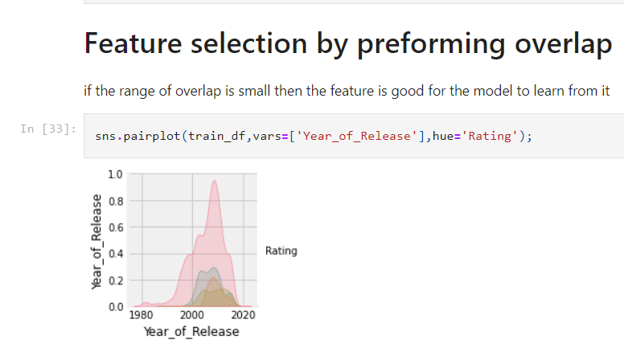
We notice that all the overlap area between features and target are small but only one is bigger which is ‘year’

Slide 16
02.
Predict the model and tune hyper parameters

Slide 17
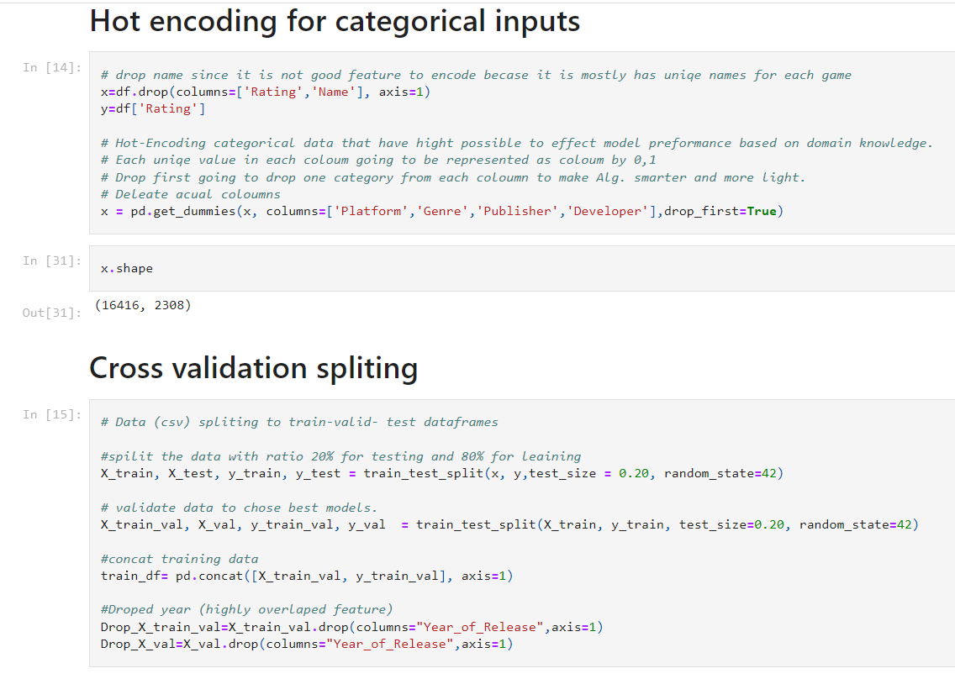

Slide 18
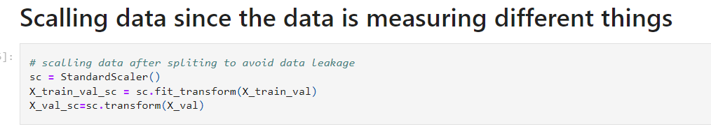

Slide 19
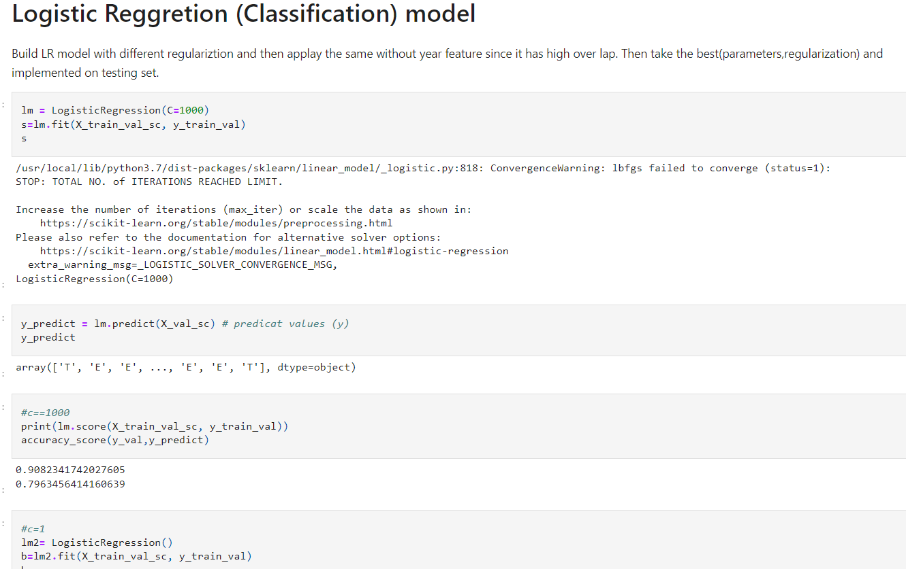

Slide 20
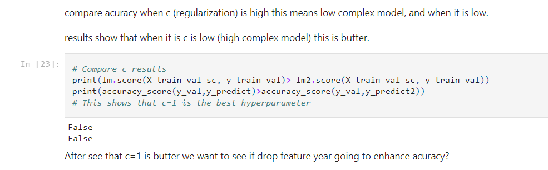
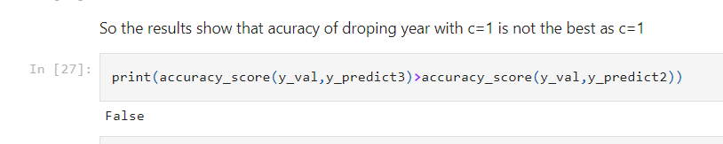

Slide 21
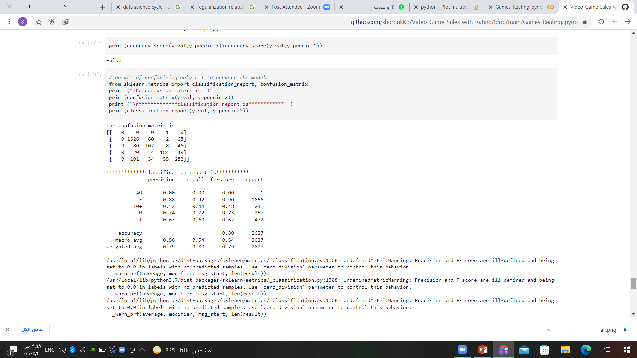

Slide 22
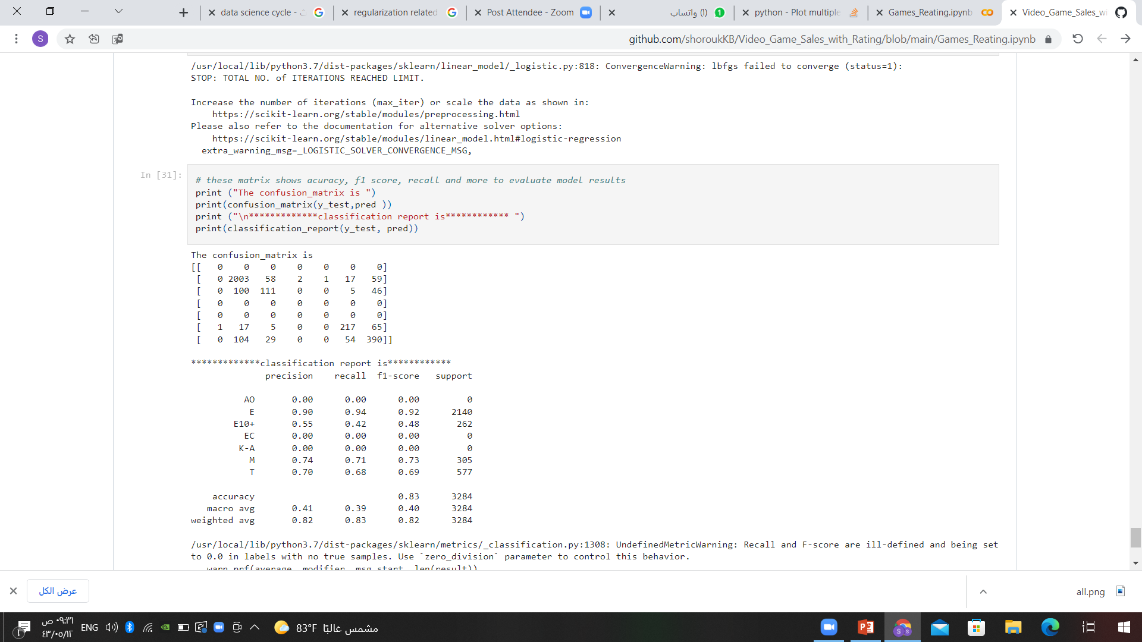
final testing result:

Slide 23
Thanks!

